Slide 1
Neural Networks are Decision Trees
Nov. 17, 2022
Gwangwoo Kim

Slide 2
Introduction
The efforts in explaining neural network decisions can be categorized into several approaches: saliency maps, approximation by interpretable methods and joint models.

Slide 3
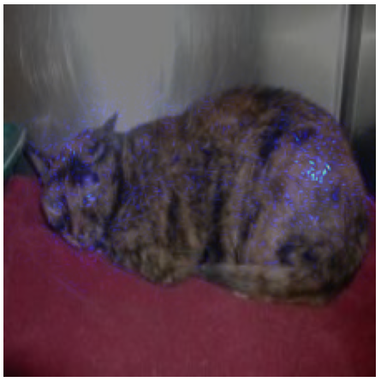
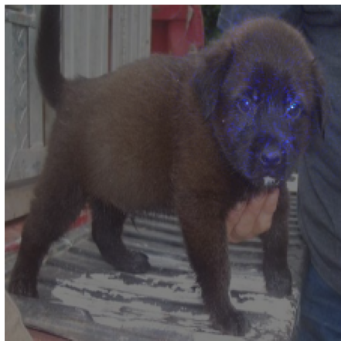
Introduction
Saliency map

Slide 4
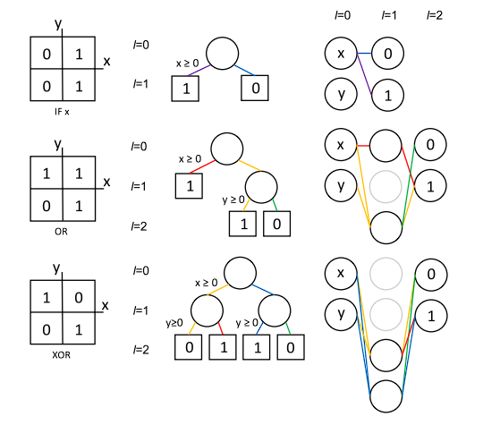
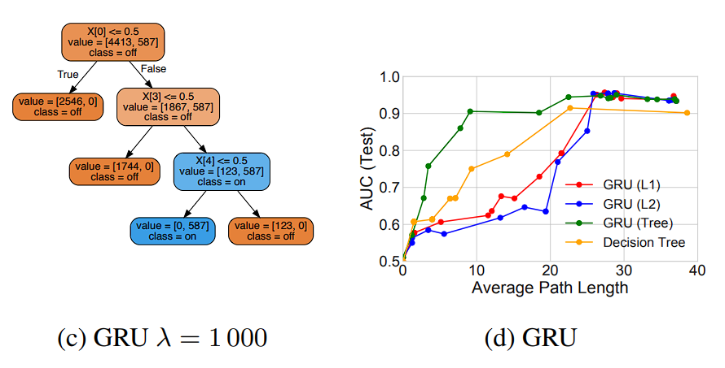
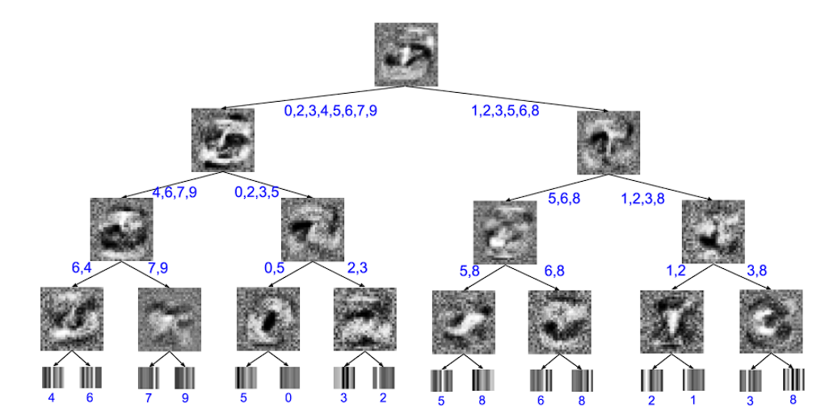
Introduction
Approximation by interpretable methods
Deep neural network initialization with decision trees. (2018)
Beyond sparsity: Tree regularization of deep models for interpretability. (2018)
Distilling a neural network into a soft decision tree. (2017)

Slide 5
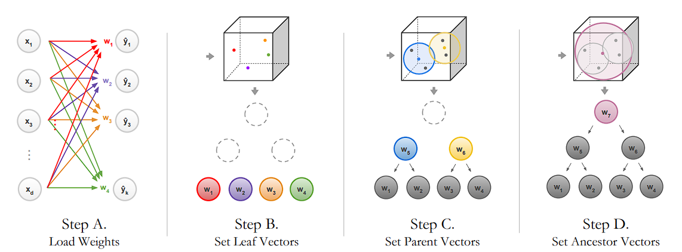
Introduction
Joint model
Neural-backed decision trees (2020) generally uses deep learning to assists some trees, or come up with a neural network structure so it resembles a tree.

Slide 6
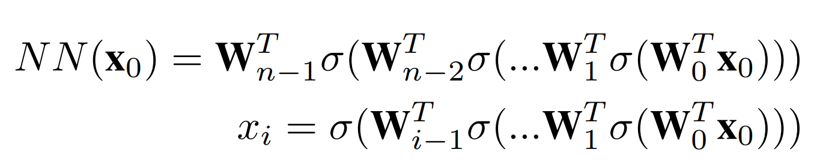
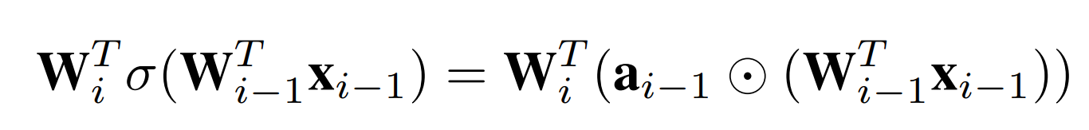
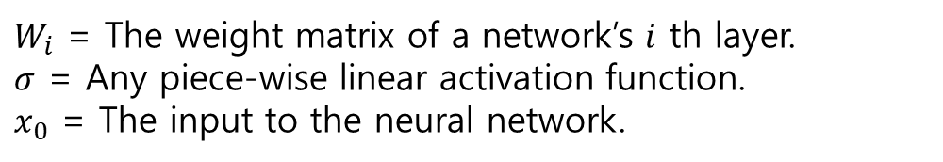
Fully Connected Networks
$W_{i}$ = The weight matrix of a network’s $i$ th layer.
$σ$ = Any piece-wise linear activation function.
$x_{0}$ = The input to the neural network.
$a_{i−1}$ is a vector indicating the slopes of activations

Slide 7
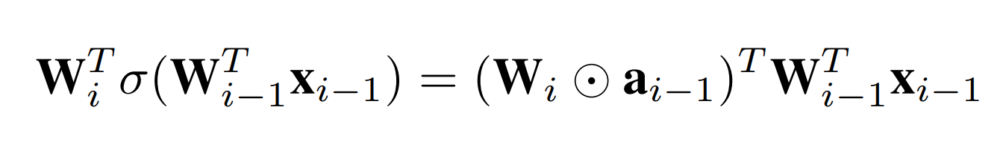
Fully Connected Networks
$W_{i}$ = The weight matrix of a network’s $i$ th layer.
$σ$ = Any piece-wise linear activation function.
$x_{0}$ = The input to the neural network.
a column-wise element-wise multiplication

Slide 8
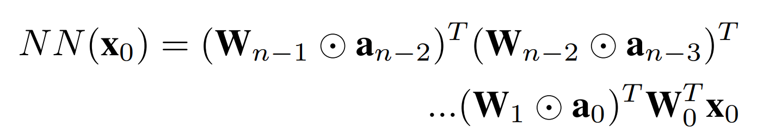
Fully Connected Networks
$W_{i}$ = The weight matrix of a network’s $i$ th layer.
$σ$ = Any piece-wise linear activation function.
$x_{0}$ = The input to the neural network.

Slide 9
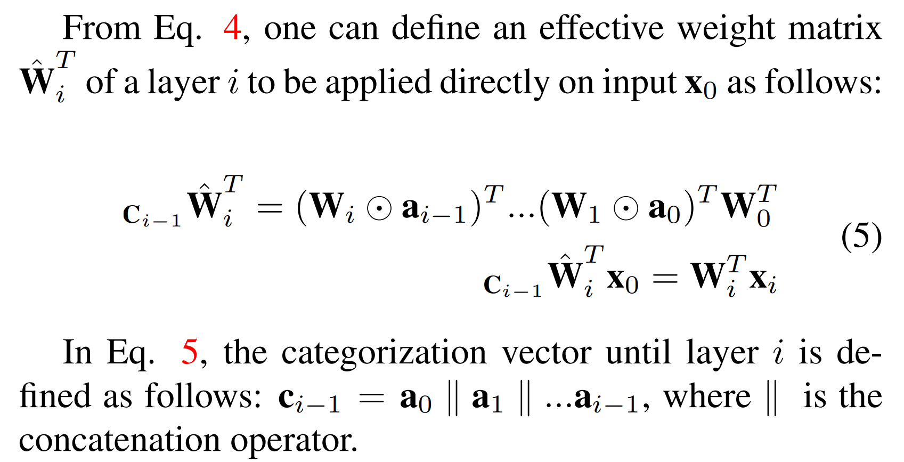
Fully Connected Networks

Slide 10
Fully Connected Networks
A fully connected neural network can be represented as a single decision tree.

Slide 11
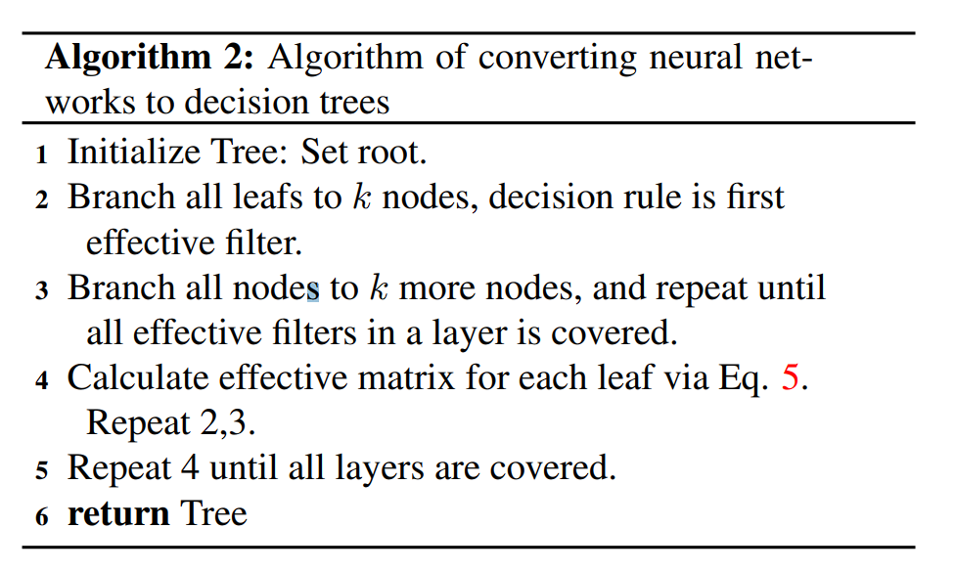
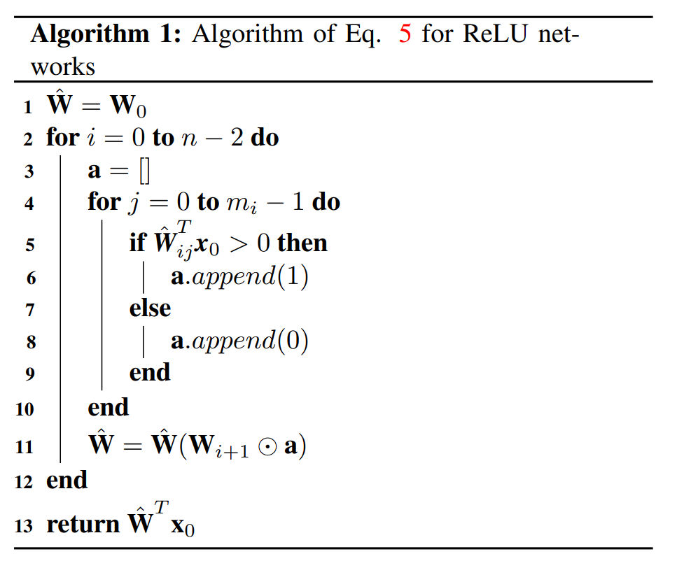
Fully Connected Networks

Slide 12
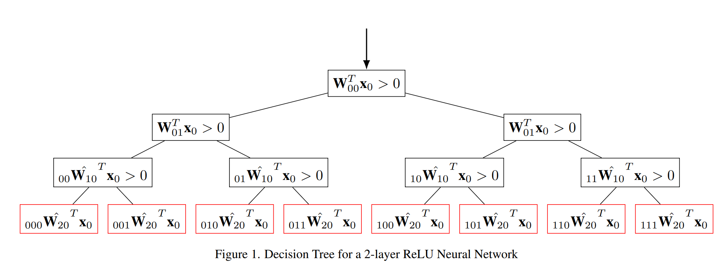
Fully Connected Networks

Slide 13
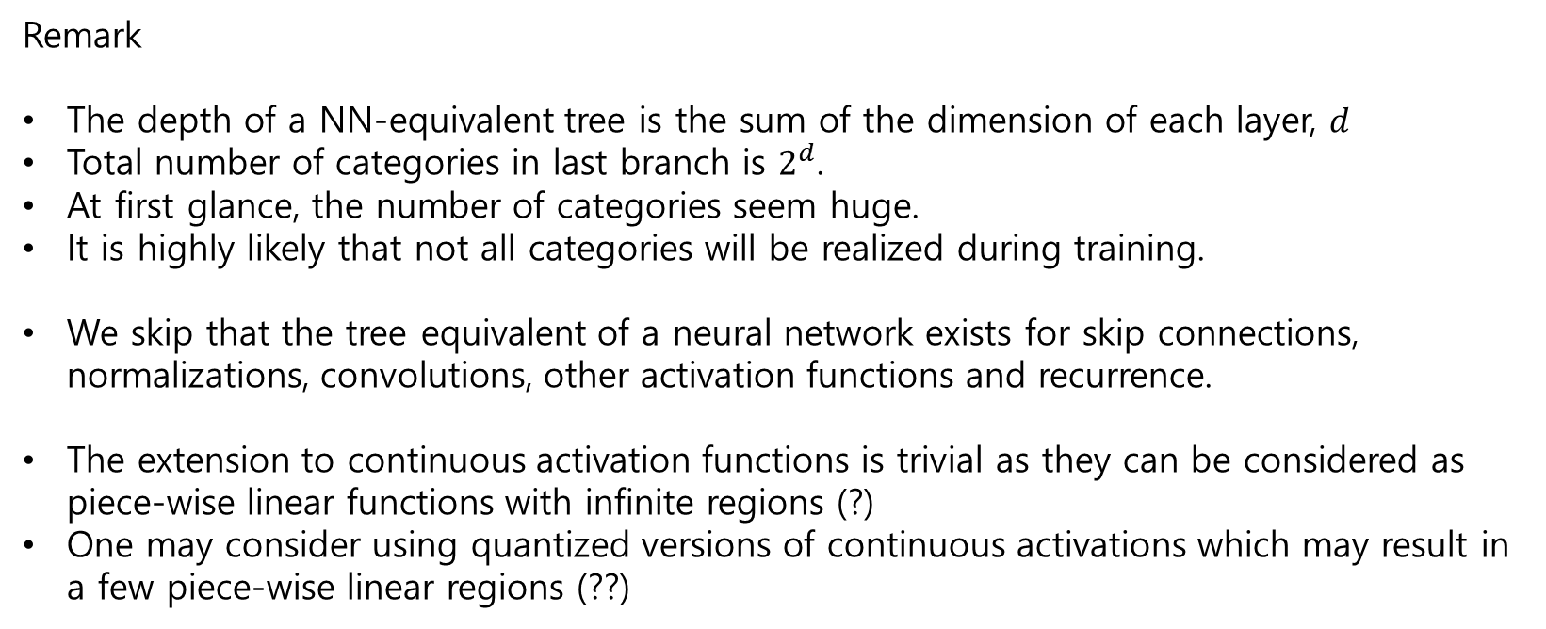
Fully Connected Networks
Remark
The depth of a NN-equivalent tree is the sum of the dimension of each layer, $d$
Total number of categories in last branch is $2^{d}$.
At first glance, the number of categories seem huge.
It is highly likely that not all categories will be realized during training.
We skip that the tree equivalent of a neural network exists for skip connections, normalizations, convolutions, other activation functions and recurrence.
The extension to continuous activation functions is trivial as they can be considered as piece-wise linear functions with infinite regions (?)
One may consider using quantized versions of continuous activations which may result in a few piece-wise linear regions (??)

Slide 14
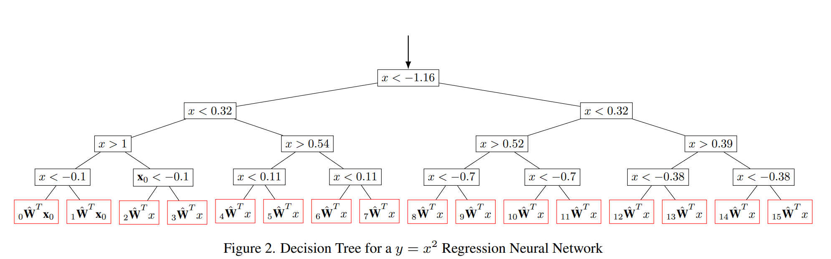
Experimental Results

Slide 15
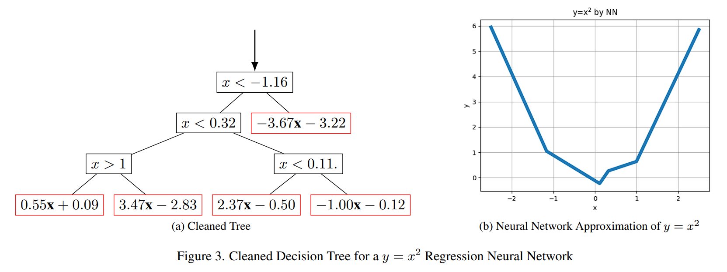
Experimental Results

Slide 16
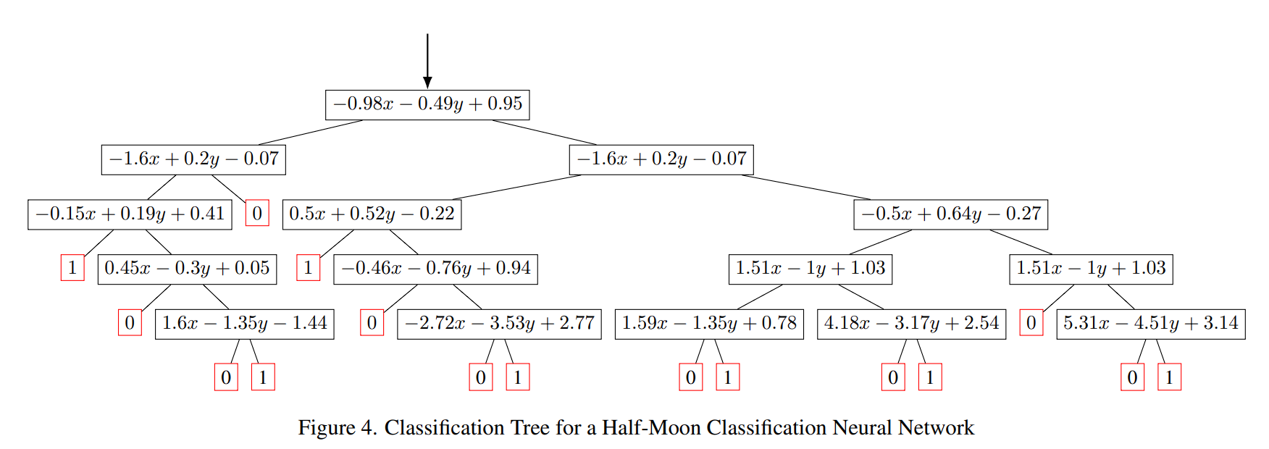
Experimental Results

Slide 17
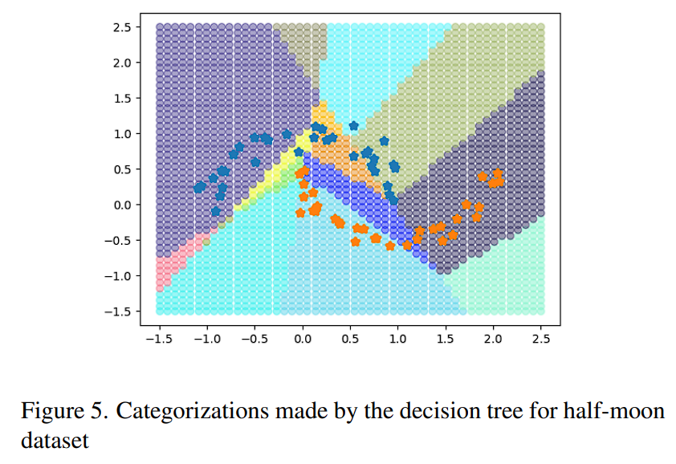
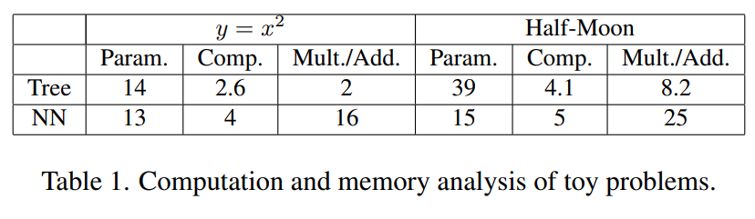
Experimental Results

